Slide 1
HTML5
Adapters
AGV
WPF
EAS
Adapters
Adapters
Raspberry PI
Foundation
Ensor
Common
Enterprise
MySQL
Interfaces
Interfaces
ElasticSearch
Project X
SQL Server
Interfaces
Docker
Android
IOS

Slide 2
Requirements

Slide 3
Archimate
Business Layer
Requirements

Slide 4
Requirements
Features
Use Cases

Slide 5
Requirement
Feature
Motion Lights
AGV
Feature
LightManagement
<<include>>
Requirement
Feature
Motion Sounds
SecurityManagement
Feature
SoundManagement
Requirement
Alarm

Slide 6
Requirements
Features
Use Cases
Documentation
Test Cases

Slide 7
Archimate
Business Layer
Requirements
Features
Use Cases
Documentation
Test Cases

Slide 8
Requirements
Features
Use Cases
Use Case Scenarios
Documentation
Test Cases

Slide 9
Requirements
Features
Use Cases
Use Case Scenarios
Activity Diagram
Documentation
Test Cases

Slide 10
Requirements
Archimate
Application Layer
Features
Use Cases
Use Case Scenarios
Activity Diagram
Documentation
Test Cases

Slide 11
Requirements
Archimate
Application Layer
Features
Use Cases
Use Case Scenarios
Activity Diagram
Documentation
Test Cases
Archimate
Technology Layer

Slide 13
Requirements
Features
Use Cases
Use Case Scenarios
Documentation
Test Cases
Test Scenarios
TDD Feed
Code

Slide 14
Requirements
Features
Use Cases
Use Case Scenarios
Designer Input
Documentation
Test Cases
Test Scenarios
TDD Feed
Code

Slide 15
Requirements
Features
Use Cases
Use Case Scenarios
Generated
Documentation
Test Cases
Test Scenarios
TDD Feed
Code

Slide 16
Requirements
Features
Use Cases
Use Case Scenarios
Generated
Documentation
Test Cases
Test Scenarios
TDD Feed
Code

Slide 17
Requirements
Features
Use Cases
Use Case Scenarios
Documentation
Test Cases
Test Scenarios
If needed can be manually expanded.
TDD Feed
Code

Slide 18
Requirements
Features
Use Cases
Use Case Scenarios
Documentation
Test Cases
Test Scenarios
TDD Feed
Manual (for now).
Code

Slide 20
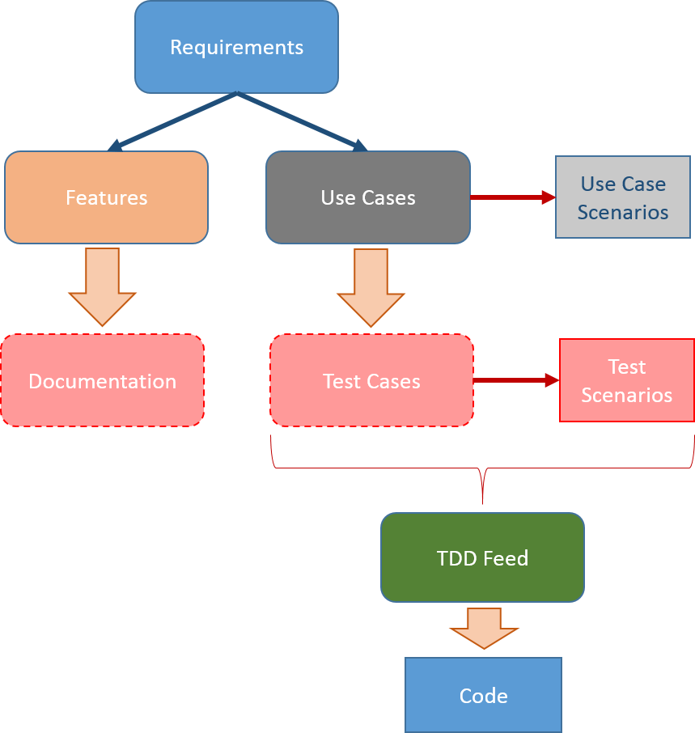
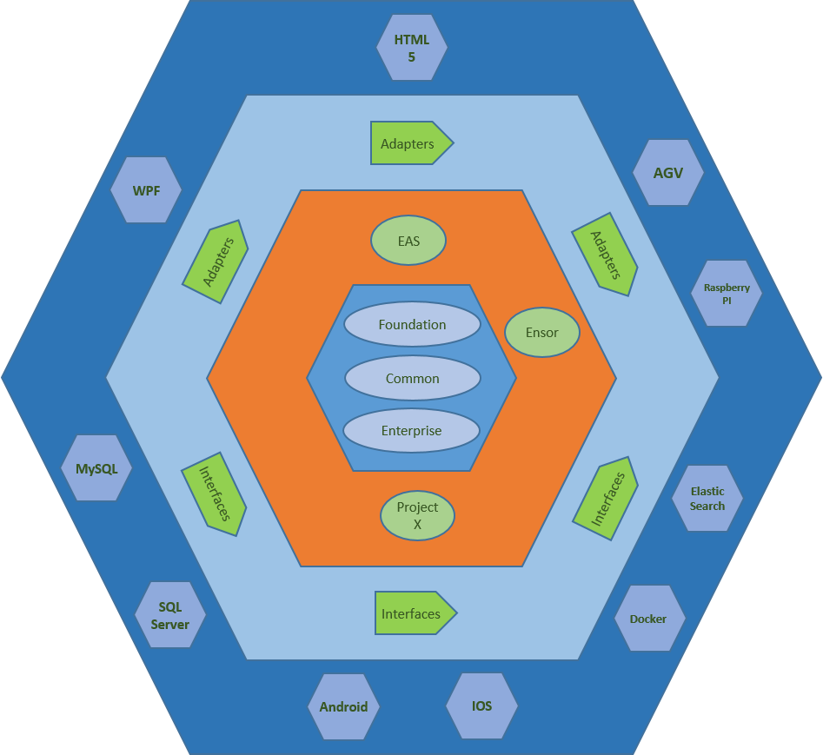
Analysis & Design
Implementation

Slide 21
Analysis & Design
Implementation

Slide 22
Analysis & Design
Implementation

Slide 24
SOLID
YAGNI
Law of Demeter
Guidelines
Key Values
Tools
Developer’s Backpack

Slide 25
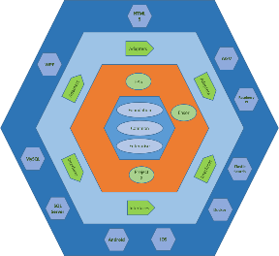
Root Supervisor
Isolated
Messaging
Queueing
Atomic
Actor B
Actor A
Actor C

Slide 26
Key Values
Technology Independence.
Test Driven.
Growth.

